Slide 1
Program Analysis (WS2023-24)
Course Project: Dynamic Slicing
Parth Dineshchandra Panchal
MSc. Computer Science
(Matriculation No: 3697397)

Slide 2
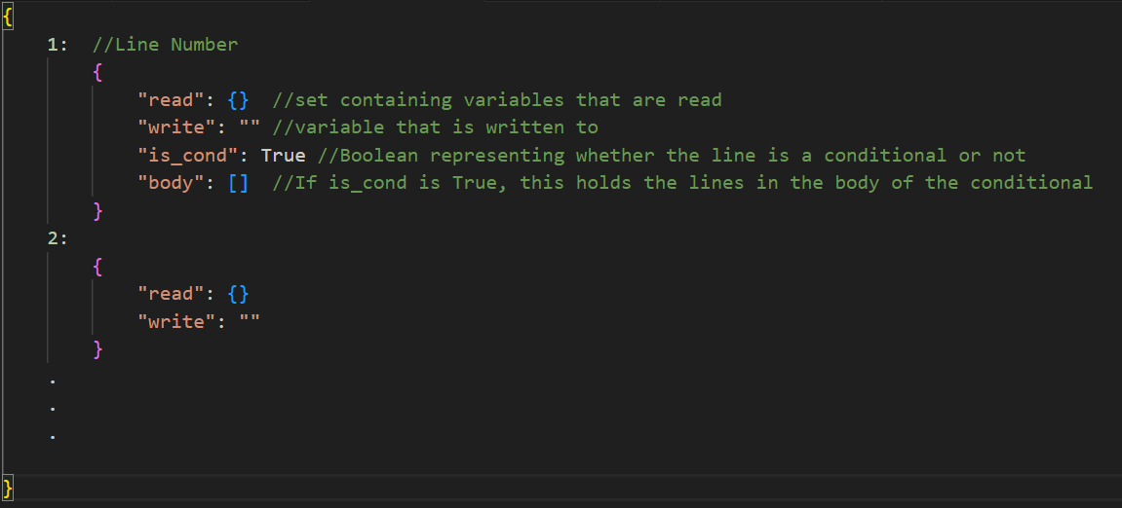
“datastore” - Structure

Slide 3
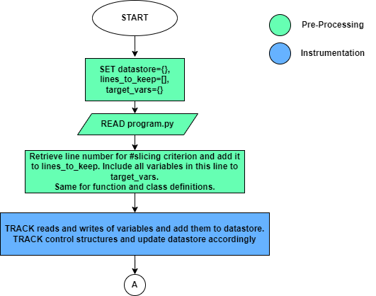
The Algorithm (1)
Notes:
Hooks: begin_execution, read, write, post_call, enter_if, enter_for, enter_while, _continue, _break, end_execution

Slide 4
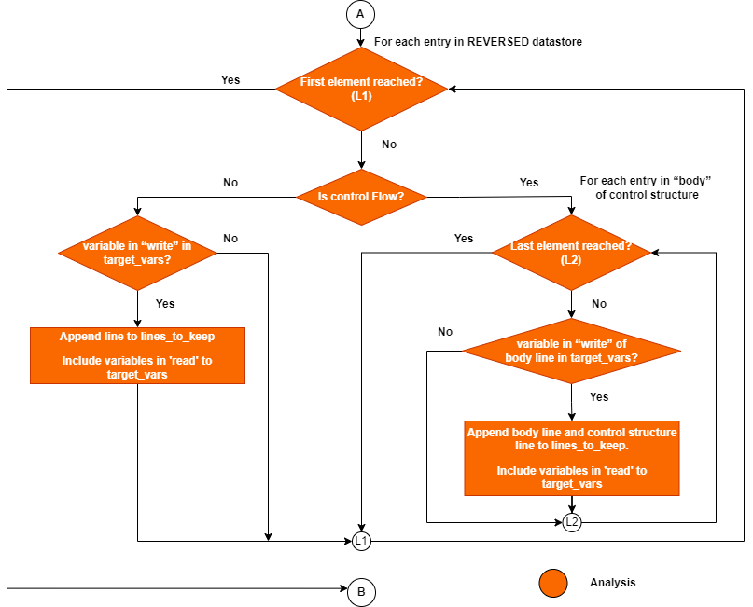
The Algorithm (2)

Slide 5
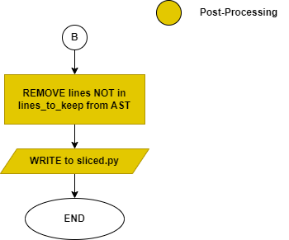
The Algorithm (3)

Slide 6
Additional Test Cases
Milestone | Test Case # | Description
2 | test_11 | To test when slicing criterion has return x + y i.e. Multiple variables in the return statement
 | test_14-18 | To test more with objects
 | test_19-22 | To test cases with string concatenation & fstrings
 | test_23 | To test overwritten values. E.g. x=1; y=2; x=4
 | test_29 | To test passing multiple arguments to a function e.g., a.Add(x, y)
 | test_30-31 | To test other data types like sets and tuples
3 | test_11 | To test if..elif..else
 | test_13-15 | To test multiple conditions in if joined with logical operators
 | test_18 | To test whether the definition of variables in the condition that is evaluated to false is kept or not (for if else case)
 | test_20-24 | To test nested if
 | test_25-30 | To test loops
 | test_31-32 | To test nested for and while
 | test_33-34 | To test loops with break and continue
Shortcomings: Object Aliases, Match Case, Loop-Else, AST structures

Slide 7
Thank You!

